Slide 1
GCBASIC
PIC18FxxQ24
Part 6 – Using the reset switch

Slide 2

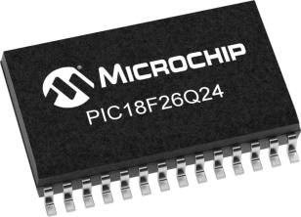
GCBASIC
PIC18FxxQ24
Part 6 – Using the reset switch

Slide 3
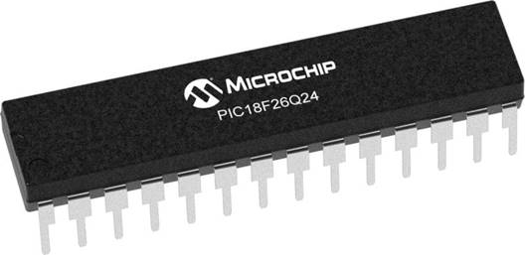
GCBASIC
Like and subscribe!

Slide 4
PIC18FxxQ24
PIC18-Q24 is a high performance PIC18
Digital and Analog peripherals
10-bit ADC
Multiple communication interfaces
Serial, I2C and SPI
PWM – CCP/PWM and 16Bit
Configurable Logic Cells
Multi voltage domains
The PIC18xxQ24 offers 28, 40 and 48-pin products in small footprint packages to support customers in a wide variety of applications.

Slide 5
Videos...
Install the hardware and make the board work – three LED programs
Make four LEDs flash in a sequence
Set the LEDs to represent the value of ADC
Sequence the LEDs with a delay using the value of ADC
Using an input to set the state of the LEDs
Using the reset switch
Using the switch, ADC – make the LEDs flash in a sequence with reverse
Using the serial to display values
Using the timer0 overflow, 8bit timer, 16bit timer to flash the LEDs
Using EEProm – showing values on the serial terminal, and more constants insights
Using I2C with serial to discover I2C devices
Using an I2C GCLD display
Using a SPI GCLD display
Using PWM, 7 ways, to dim the LEDS
Using an external interrupt to control an LED
Using storage within the chip – Progmem, SAF memory, EEPROM and DATA blocks
Using CLC
The GCBASIC tool chain
Assembly , alternatives assemblers and MPLAB-X
Summary

Slide 6
GCBASIC Compiler
GCBASIC Compiler
GCBASIC is an Open Source compiler for PIC and AVR microcontrollers
GCBASIC now supports the 18FxxQ24 chip family

Slide 7
Prerequisites
Assumes you have
Installed the GCBASIC software
Installed your programmer software
Test that you have the 18FxxQ24 attached
You have the 4 LEDs operating
You have a POT connected
You have SWITCHes connected

Slide 8
Using the Reset as input or Master Clear
The switch is connected RE3
The configuration switches control the operation of RE3
MCRLE
EXTMCRL - pin is MCLR
INTMCRL - pin function is port defined function

Slide 9
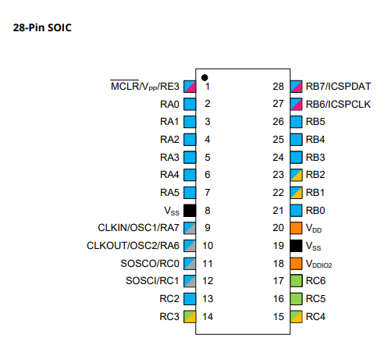
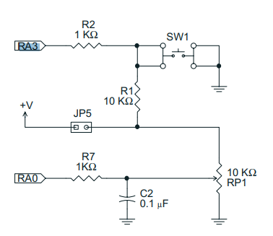
Digital input
Switch
RE3

Slide 10
Hardware
Hardware
-------------------PORTA----------------
Bit#: -7---6---5---4---3---2---1---0---
IO: ----------------SW----------ADC--
----------------------------------------
-------------------PORTB----------------
Bit#: -7---6---5---4---3---2---1---0---
IO: ----------------LED-LED-LED-LED--
----------------------------------------
------------------PORTC-----------------
Bit#: -X---6---5---4---3---2---1---0---
IO: -^-------------------------------
-----VDDIO2-----------------------------
You must apply correct Voltage
------------------PORTE-----------------
Bit#: -----------------3---------------
IO: -^--------------SW---------------
Prototype Board
Power 5v0
Programmer
LEDs & resistors
Switches & resistors

Slide 11
Tutorial overview
Initialise
Flash an LED
Do Forever
Part 1 – RE3 as input
Initialise
Check the reset switch
If pushed then toggle LED
Part 2 – RE3 as reset
Initialise
Resets every time…
RSTButton = 0
Yes
No
Set LED State
Loop

Slide 12
Lab
Review PICINFO options
Examine the sample code
Review the results

Slide 14
Videos...
Install the hardware and make the board work – three LED programs
Make four LEDs flash in a sequence
Set the LEDs to represent the value of ADC
Sequence the LEDs with a delay using the value of ADC
Using an input to set the state of the LEDs
Using the reset switch
Using the switch, ADC – make the LEDs flash in a sequence with reverse
Using the serial to display values
Using the timer0 overflow, 8bit timer, 16bit timer to flash the LEDs
Using EEProm – showing values on the serial terminal, and more constants insights
Using I2C with serial to discover I2C devices
Using an I2C GCLD display
Using a SPI GCLD display
Using PWM, 7 ways, to dim the LEDS
Using an external interrupt to control an LED
Using storage within the chip – Progmem, SAF memory, EEPROM and DATA blocks
Using CLC
The GCBASIC tool chain
Assembly , alternatives assemblers and MPLAB-X
Summary

Slide 15
GCBASIC
PIC18FxxQ24
Part 6 – Using the reset switch

